Slide 1
Formal Speciﬁcations for Documentation and Evaluation
Nauman bin Ali (nal@bth.se),
Michael Unterkalmsteiner (mun@bth.se)
Notes:
We have seen a number of different ways of documenting software architectures ranging from informal to formal specification.
One way of doing formal specifications is using architecture description languages. Today we will introduce one such language called the architecture analysis and design language.

Slide 2
Architecture Analysis and Design Language (AADL)
A modeling language for describing software and hardware system architecture for real-time embedded systems.
History
MetaH and ACME
Avionics Architecture Description Language
Standardized by Society of Automotive Engineers (SAE)
Domain
Embedded real-time systems
Notes:
AADL is a modeling language for describing both the software and hardware architecture of real-time embedded systems. It has been standardized by Society of Automotive engineers

Slide 3
Beneﬁts
Industry standard
Promotes reuse and helps communication
One model for multiple evaluations
Performance, latency analysis, resource budgeting etc.
Reduced model validation cost
Tool support
Open source and commercial software tools
Allows early analysis (e.g. resource budget analysis)
Automated analysis.
Notes:
Being an industry standard helps in wide spread adoption and that will help promote reuse and communication.
AADL supports different types of analysis on one model instead of developing multiple multiple models.

Slide 4
Open Source AADL Tool Environment (OSATE)
Tool developed by SEI that uses Eclipse
Osate 1.5.10 (used in this course)
Osate 2.1 implements AADL V2
Supports both textual and graphical representation
Consistency and syntax checking
Plugins for analysis
Supports development of new analysis plugins
Notes:
1.5.10 now supports conversion of existing projects to AADL V2

Slide 5
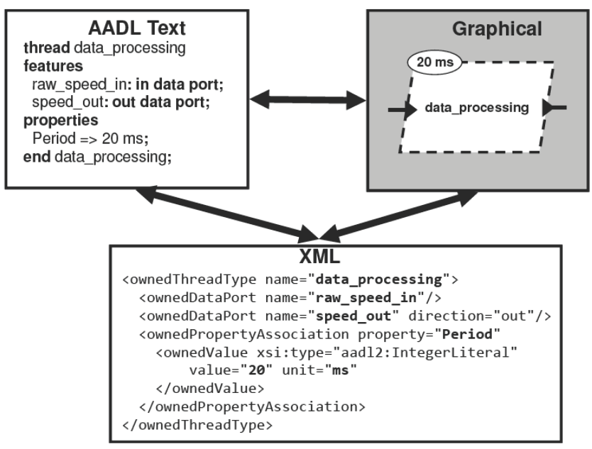
AADL representations

Slide 6
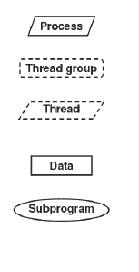
Application software components
Process: protected address space
Thread group: logical organization of thread
Thread: a schedulable unit that can execute concurrently
Data: data types, static data, potentially sharable
Subprogram: representing a callable piece of source code.
Notes:
The AADL can describe how components interact, such as how data inputs and outputs are connected or how application software components are allocated to execution platform components. T

Slide 7
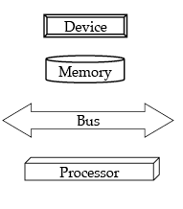
Execution platform components
Processor: schedules and executes threads
Memory: stores code and data
Device: represents sensors, actuators, or other components that interface with the external environment
Bus: interconnects processors, memory, and devices

Slide 8
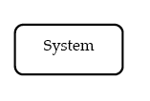
Composite components
System: design elements that enable the integration of other components into distinct units within the architecture

Slide 9
Limitations
No documentation of decisions, rationales and assumptions.
It is not a framework to develop architecture
It is a modeling language to document and analyze the architecture

Slide 10
Assignment: Blunderjack system
In the field of forest harvesting, many accidents happen because of the dangerous working environment. Even though accidents will happen in the future as well, those that are the result of human error can be eliminated through computational power and computer systems. This is a description of such a system.
The system shall be contained in a forest harvesting machine. Such machines are built for processing timber. The system uses sensors attached to the machine for measuring angles, extension, rotation etc.
The system will be part of the operational system of the machine; in one end commands from the operator will be taken in from a digital joystick and in the other end signals to the hydraulic system will be sent. In addition, signals from the sensors assembled in the crane will be received and interpreted by the system.
The most important system objective is to make sure that no accidents occur. This is done by preventing the driver to make unsafe moves with the arm causing the machine to tip over, or feeding a tree through the processing aggregate in direction towards the cabin, or trying to lift more weight than the machine can handle.
In order for the system to be transparent to the operator, the slack time between an input signal from the joystick and an output signal to the hydraulic system (i.e. a movement in the crane) must be less than 0.4 seconds.

Slide 11
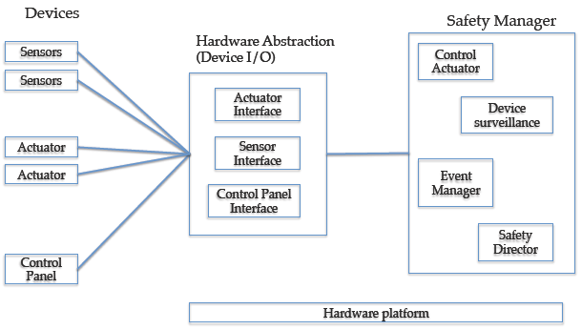
Blunderjack system
Device manager

Slide 12
Evaluation goals
Resource allocation analysis
Given the three configurations select the optimum one
Latency Analysis
Given the two scenarios evaluate the end-to-end latency

Slide 13
Example analysis
Resource budget analysis
Flow latency analysis

Slide 14
Example 1: Resource budget analysis
Initial model: with top-level application and hardware parts.
Prescribe constraints: processing capacity in MIPS and memory in MB.
Budget total vs. available capacity.
Notes:
Install the tool
Import the project

